Slide 1
GM - UAW
Benefits

Slide 2
FOR BENEFIT INFORMATION AND ASSISTANCE
GM BENEFITS & SERVICES CENTER
www.gmbenefits.com
1-800-489-GMGM (4646)
TTY - 1-877-347-5225
The GM Benefits & Services Center is the best source of information for the programs listed below:
DISABILITY
• Sickness & Accident Benefits
• Extended Disability Benefits
Dependent Care
• Health Care – Entry Level Employees
HEALTH CARE RELATED SERVICES
• Medical
• Dental & Vision
• Prescription Drug
• COBRA
Continued on next slide

Slide 3
LAYOFF BENEFITS (SUB)
LIFE INSURANCE
• Basic Life & Extra Accident
• Optional Life, Dependent Life & Personal Accident
• Survivor Income Benefit Insurance
PENSION PLAN
PERSONAL SAVINGS PLAN (PSP)
OTHER SERVICES
• Reporting A Death
• Service Awards
• Survivor Services Unit
• Wage & Employment Verification

Slide 4
Benefit Eligibility Matrix
Active Health Care:
Eligible for Entry level Health Care on the 91st calendar day.
This includes Dental and Vision Coverage
PSP:
Eligible after establishing seniority
PSP Retirement contribution:
6.4% contribution after establishing seniority
$1 per Compensated Hour to PSP:
Eligible after establishing seniority
Life Insurance:
Immediately Eligible
Disability:
Eligible after one year of seniority
Supplemental Unemployment Benefits:
Eligible after 1 year of seniority
Dependent Care Spending Account:
Eligible after establishing seniority
Profit Sharing:
Eligible on date of hire

Slide 5
Healthcare

Slide 7
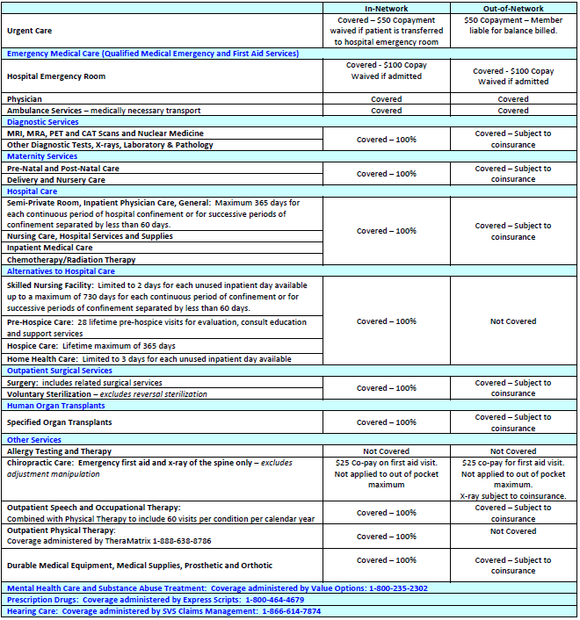

Slide 8
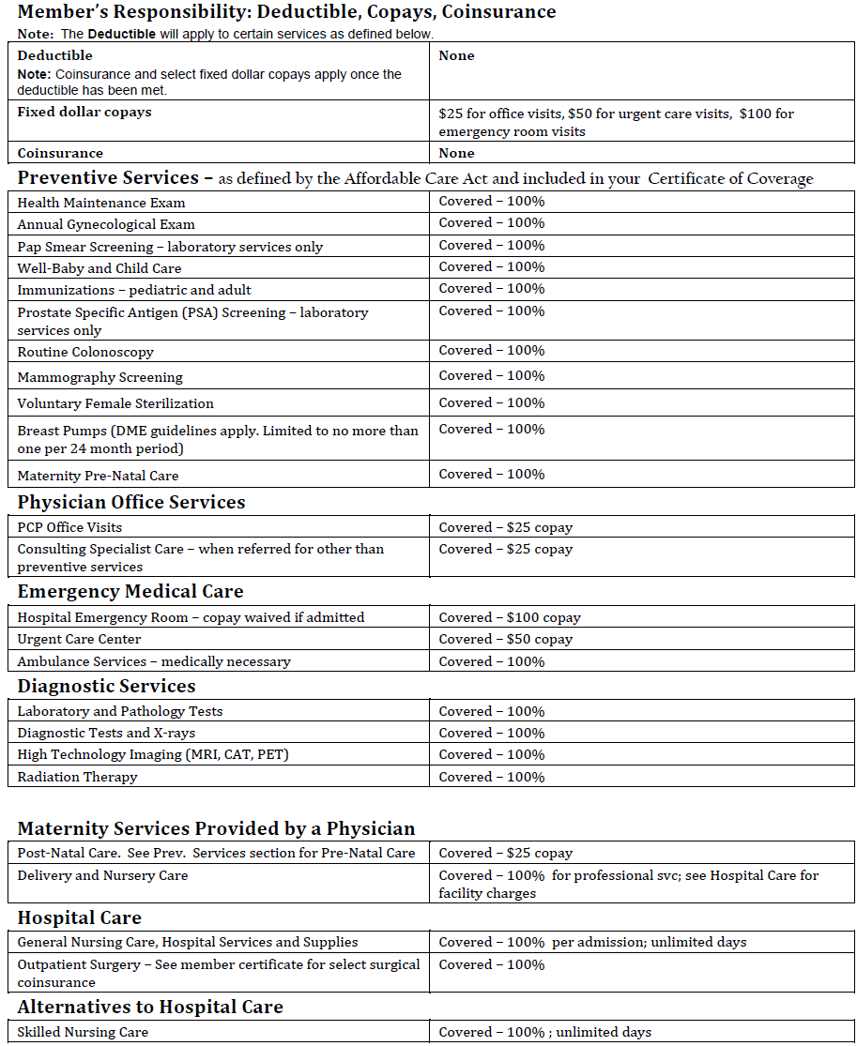

Slide 9
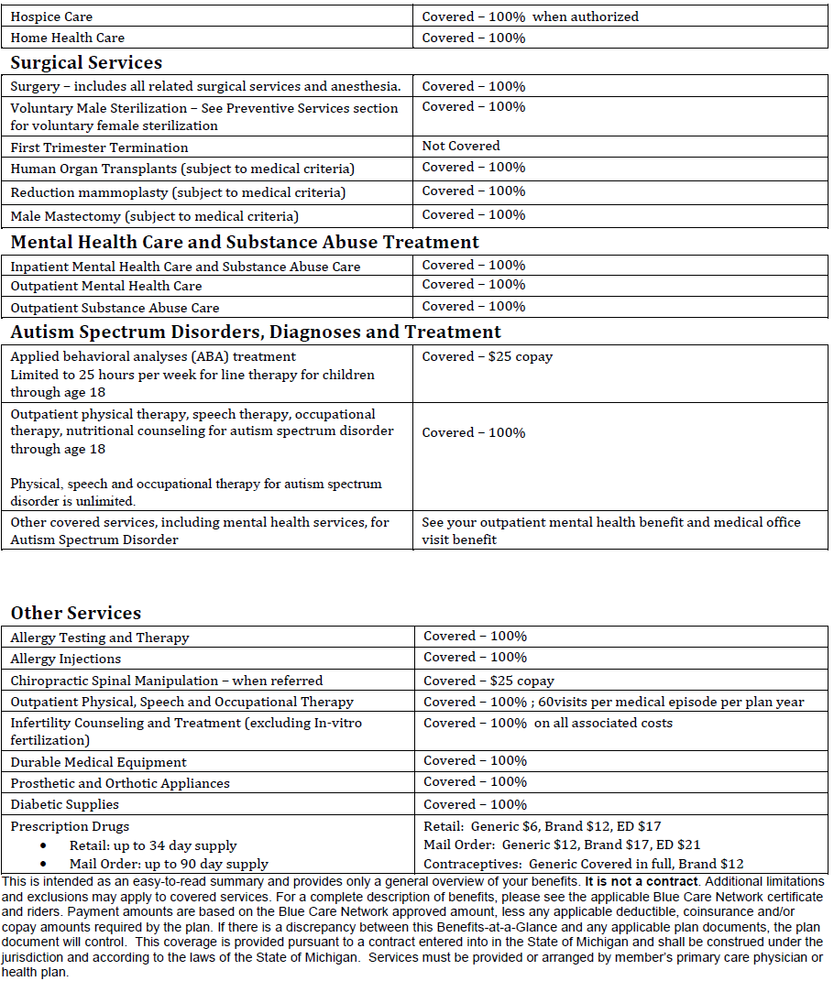

Slide 10
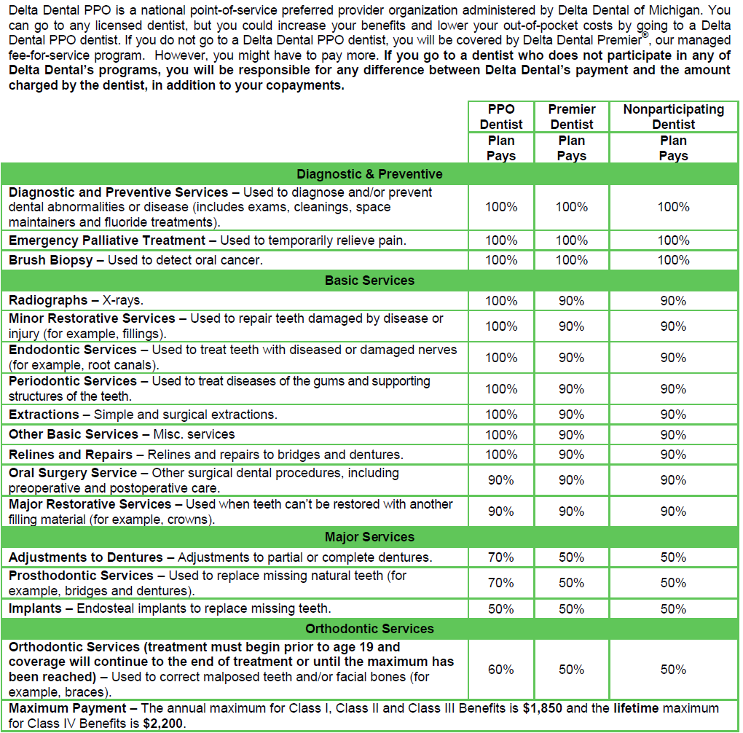

Slide 11
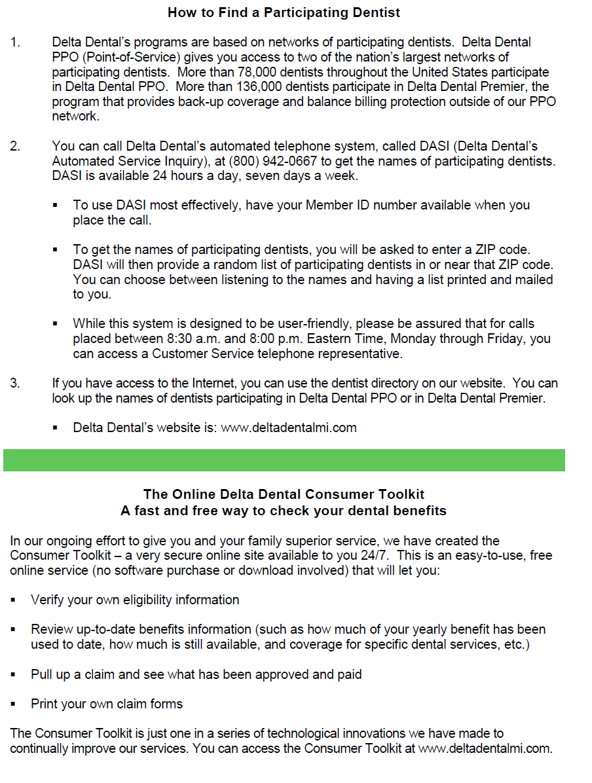

Slide 12
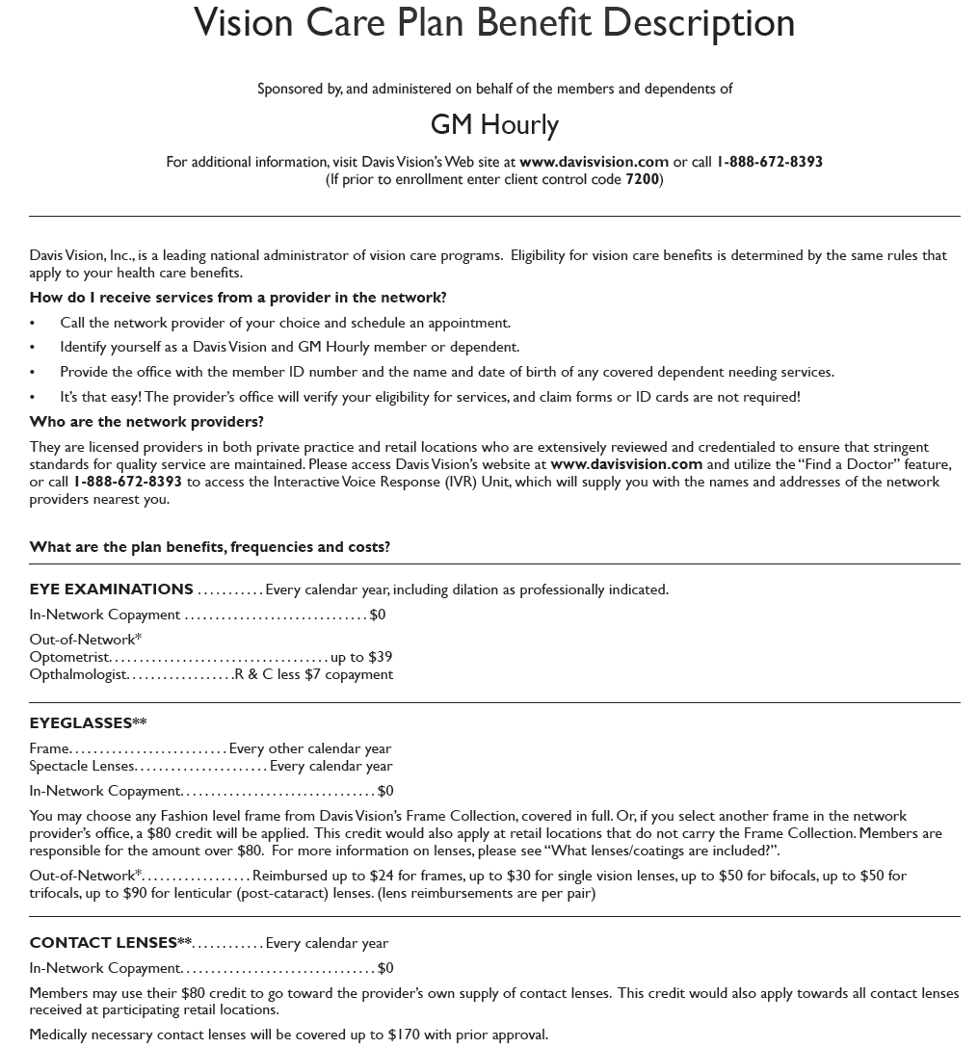

Slide 13
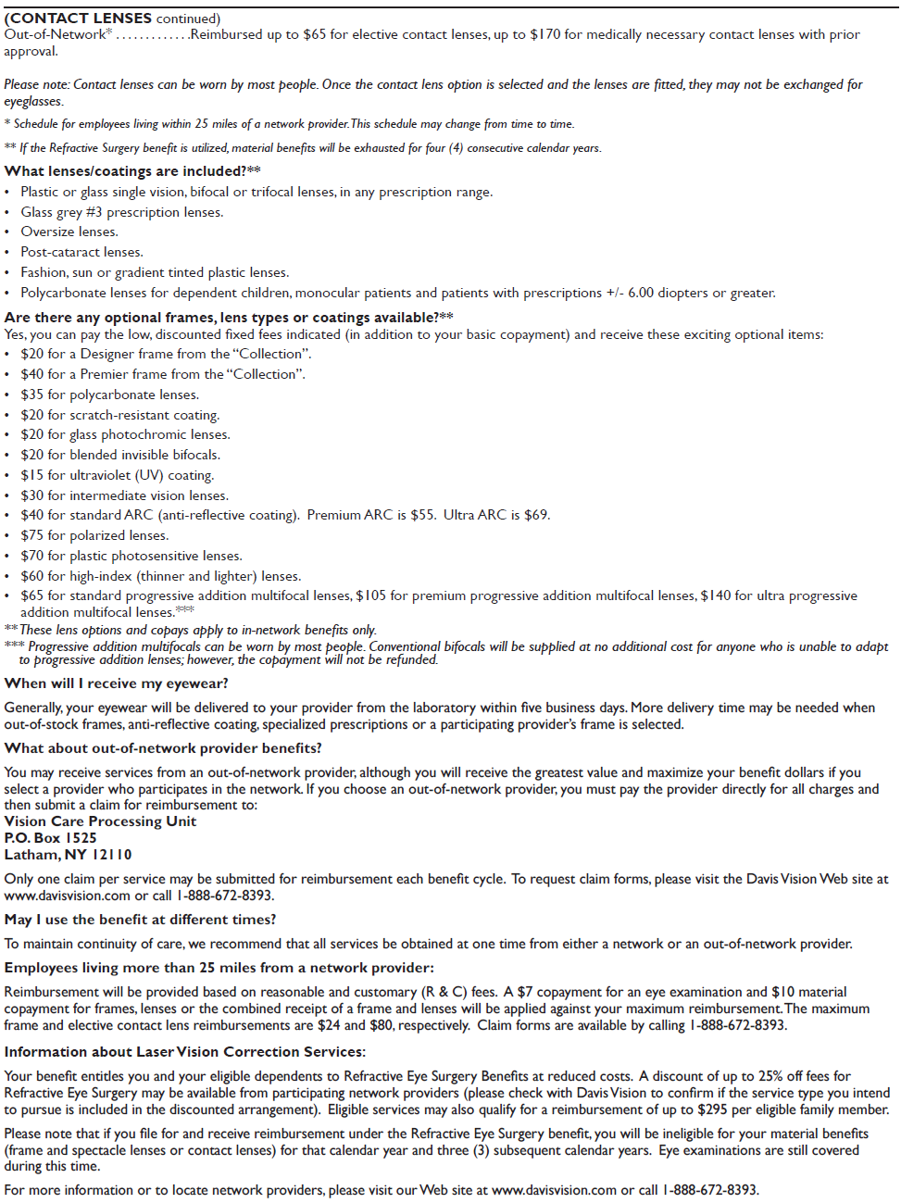

Slide 14
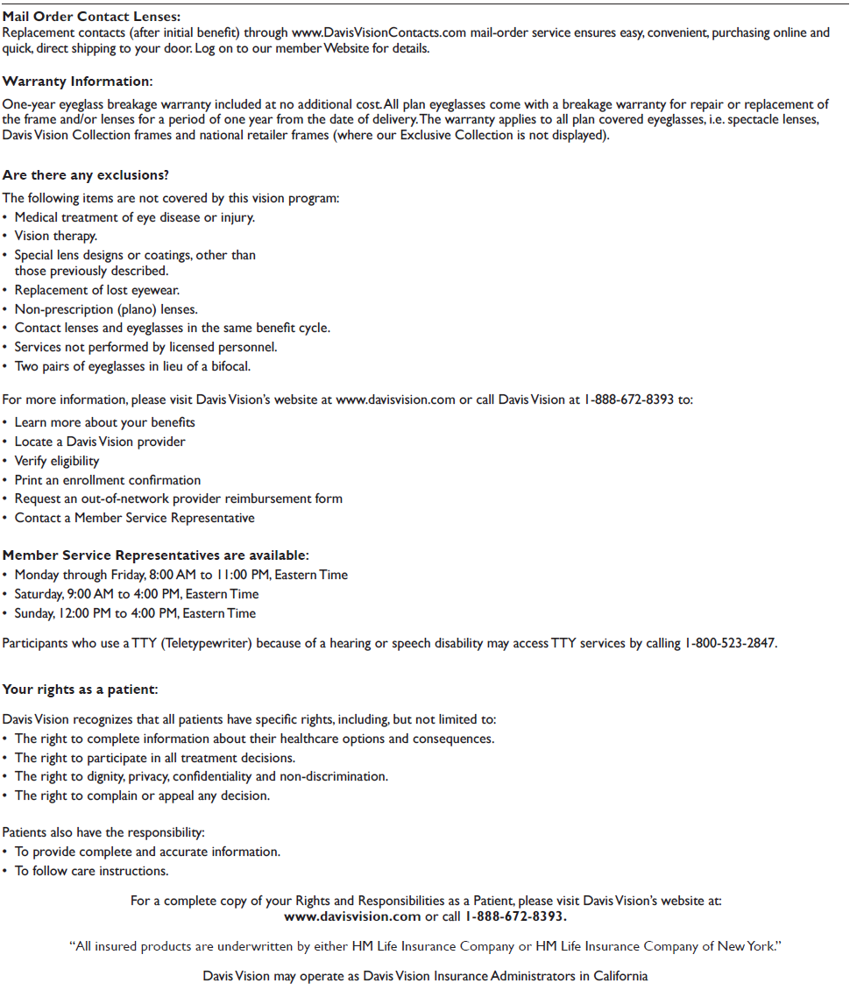

Slide 15
PSP
Eligible after 90 days seniority
Enroll in plan with various percentages
Auto enrollment at 3%
Will receive a letter prior to auto enrollment going into effect. Giving you the option not to participate.

Slide 16
Company Contributions
A dollar per compensated hour up to 40 hours per week.
This money will go into your current PSP account
If you don’t have a PSP established it will go into a default account
Vested after three years
Forfeited if loss of job prior to three years
If you rehire within 60 months it is automatically restored
No loans can be taken from this account
No withdrawals until separation

Slide 17
GM Retirement Contribution
6.4% retirement contribution
Company will contribute 6.4% of eligible weekly earnings
Up to 40 hours a week into a PSP
Vested after three years
If no employee contribution in a PSP account a default option will be used
No loans can be taken from this account
No withdrawals until separation

Slide 18
Profit Sharing
Eligible to participate on date of hire
For distribution based on compensated hours up to 1850 hours
If you work less than 1850 hours the amount will be pro-rated according to your actual compensated hours

Slide 19
Dependent Care Spending Account
Eligible first pay period after obtaining seniority
Reimburse employees for certain covered eligible dependant care expenses
Maximum benefit $5000 per plan year, $2500 if filing separate (examples of items covered are daycare, babysitting, nursery or pre-schools, etc….

Slide 20
Disability/S&A/EDB
Wages paid while on an approved disability leave
S&A - Sick and Accident
Eligible after one year seniority
1 but less than 3 years, receive up to 26 weeks
3 or more years seniority receive 52 weeks
EDB – Extended Disability Benefits
1 but less than 3 years seniority, receive 13 weeks
3 but less than 5 years seniority, receive 26 weeks
5 years but less than 10 years seniority, you will receive what you worked = time for time
10 years or more, receive until the age of 65

Slide 21
Sub-Pay
Supplemental Unemployment Benefits
Eligible after 1 year seniority
1 but less than 3 years seniority, receive 13 weeks
3 years or more, receive 26 weeks
Amount is 74% base hourly rate times 40 hours minus any state unemployment benefits received

Slide 22
Life Insurance – Entry Level
Basic and extra accident insurance eligible the first day of employment at no cost to the employee
Basic $45,000
Extra Accident $22,500
Optional and Dependent life Insurance available
Coverage amounts and premiums vary. Contact the GM Benefits and Services Center for more information.

Slide 23
How to contact your Benefit Representative
Normal Benefit Calls are taken through
your Group Leader
On sick-leave, layoff, etc… you can always call the hall at 517-372-7581 ext. - 500

